Slide 1



Communication and In-group Working Skills

Slide 2
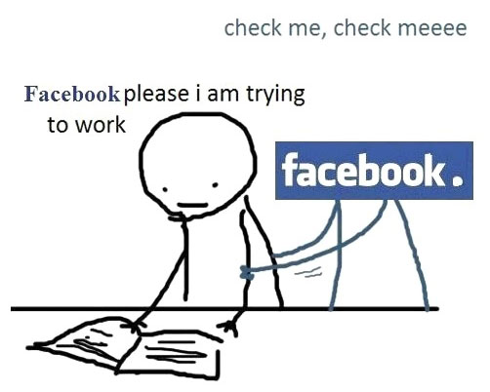



For efficiency, please!
Check meeeeee….
WORKING RULES
BE ACTIVE
AVOID DISTRACTION
Silent phone
No personal chats
No social media
PREPARE YOURSELF
These things will improve your scores!
BE ON TIME…
2

Slide 3
CLASS RULES
Attendance check 10’ after class starts
Submit assignments on time
Respect (self and others)
No personal activities
Right attitude

Slide 4
COURSE SYLLABUS

Slide 5
SYLLABUS
COURSE DESCRIPTION
This course will cover both working in groups and communication skills - both classic and current theories of group communication & team work that focus on "how groups work" and include practical information on group communication strategies and skills that emphasize "how to work in groups".

Slide 6

SYLLABUS
ASSESSMENTS (MARKS)
- 01 Participation: 10%
- 02 Group Assignments: 20%
- 03 Activities: 15%
- 01 Quiz: 05%
- 01 Group Project: 30%
- 01 Final exam: 20%
Conditions to pass:
- Final exam >= 4
- Grade Average >= 5/10

Slide 7
FORMING GROUPS
ACTIVITY
5-7 members/a group
Introduce and get to know each other.
Note: This group will be the group that will work with you on a project to practice the skill throughout the course.

Slide 8
GROUP AND TEAM OVERVIEW
Let’s start with the first session
I
Defining Teams and Groups

Slide 9
LEARNING OBJECTIVES
Defining Teams and Groups
Define “cooperation”
Distinguish between different social value orientations
Influences on cooperation
Explain methods psychologists use to research cooperation

Slide 10
Defining teams and groups
1

Slide 11
1. Defining teams and groups
Groupppp……….….!
What is a group?

Slide 12

1. Defining Teams and Groups
Formal groups are used to:
- Organize and distribute work
- Pool information
- Devise plans
- Coordinate activities
- Increase commitment
- Negotiate
- Resolve conflicts and conduct inquests

Slide 13
1. Defining teams and groups
Formal groups are used to:
- organize and distribute work
- pool information
- devise plans
- coordinate activities
- increase commitment
- negotiate
- resolve conflicts and conduct inquests.
Informal groups are used to:
Satisfy needs of affiliation
Act as a forum for exploring self-concept as a means of gaining support
Have an important effect on formal work tasks:
For example by exerting subtle pressures on group members to conform to a particular work rate, or as ‘places’ where news, gossip, etc., is exchanged.

Slide 14
1. Defining teams and groups
Teammmm…..….!
What is a team?

Slide 15
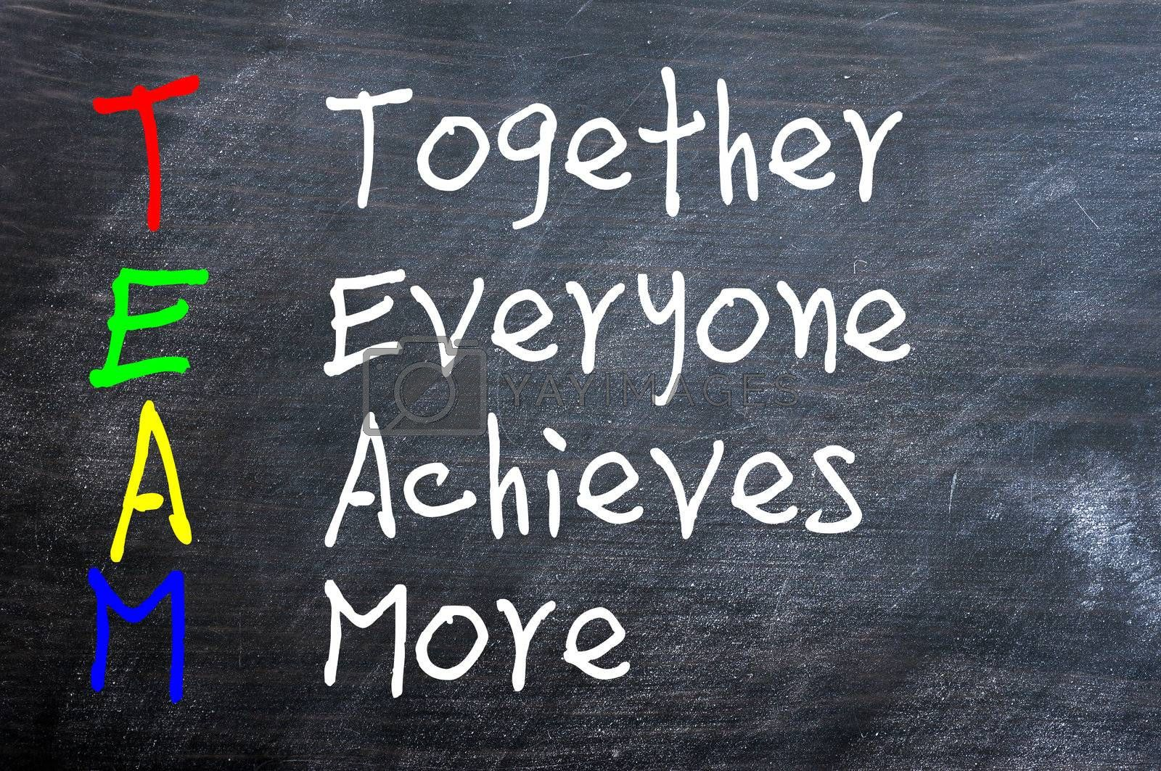
What is a team?

Slide 16


ACTIVITY 1

Slide 17
A team: as a particularly cohesive and purposeful type of work group

Slide 18

TEAM CHARACTERISTICS
A Definable Membership: a collection of three or more people identifiable by name or type;
A Group Consciousness or Identity: the members think of themselves as a group;
A Sense Of Shared Purpose: the members share some common task or goals or interests;

Slide 19
TEAM CHARACTERISTICS (cont.)
Interdependence: the members need the help of one another to accomplish the purpose for which they joined the group;
Interaction: the members communicate with one another, influence one another, react to one another;
Sustainability: the team members periodically review the team’s effectiveness;
An ability to act together.

Slide 20
ACTIVITY 2
Let choose the most characteristics with your team and explain to us why.

Slide 21
People are more willing to support and defend work they helped create.

Slide 22
ACTIVITY 3
Now, let’s discuss about risks associated with working in teams.

Slide 23

When to work alone, in groups or in teams?
When to work alone or in groups…
For simple tasks or problems
When cooperation is sufficient
When minimum discretion is required
When fast decisions are needed
When few competences are required
When members’ interests are different or in conflict
When an organization credits individuals for operational outputs
When innovative responses are sought
23

Slide 24
When to work alone, in groups or in teams?
When to build teams…
For highly-complex tasks or problems
When decisions by consensus are essential
When there is a high level of choice and uncertainty
When high commitment is needed
When a broad range of competences and different skills are required
When members’ objectives can be brought together towards a common purpose
When an organization rewards team results for strategy and vision building
When balanced views are sought
24

Slide 25
Vestibulum congue
Vestibulum congue
Vestibulum congue
Vestibulum congue
Vestibulum congue
Staff performing similar tasks
Vestibulum congue
Vestibulum congue
Vestibulum congue
Vestibulum congue
Vestibulum congue
Vestibulum congue
Vestibulum congue
Vestibulum congue
Vestibulum congue
Vestibulum congue
Vestibulum congue
Junior managers
Senior managers
Elements of a hierarchical structure
Elements of a hierarchical structure
Vestibulum congue
Vestibulum congue
Vestibulum congue
Vestibulum congue
Vestibulum congue
Vestibulum congue
Vestibulum congue
Vestibulum congue
Vestibulum congue
Vestibulum congue
Groups of junior managers
Departmental heads

Slide 26
TRADITIONAL HIERARCHICAL STRUCTURE OF ORGANIZATIONS
Staff performing similar tasks - grouped together reporting to a single supervisor;
Junior managers – responsible for several supervisors and their groups;
Groups of junior managers – reporting to departmental heads;
Departmental heads – reporting to senior managers, who are responsible for wide-ranging functions such as manufacturing, finance, human resources and marketing;
Senior managers – reporting to the managing director, who may then report to the Board.

Slide 27
TRADITIONAL HIERARCHICAL STRUCTURE OF ORGANIZATIONS
Department heads
Senior managers
Report to the managing director, who may then report to the Board.
1
1
Report to senior managers, who are responsible for wide-ranging functions such as manufacturing, finance, human resources and marketing
2
2
Group of junior managers
Report to departmental heads
3
3
Junior managers
Be responsible for a number of supervisors and their groups
4
Staff performing similar tasks
grouped together, reporting to a single supervisor
5
5

Slide 28

TRADITIONAL HIERARCHICAL STRUCTURE OF ORGANIZATIONS
Managing Director
Head of Manufacturing
Head of Engineering
Manager: Widget Production
Manager: Assembly
Manager: Packing
Day Shift Supervisor
Night Shift Supervisor
Shift Supervisor
Shift Supervisor
Senior managers
(wide-ranging functions)
Department/Unit Leads
Junior Managers
Supervisors
Staff performing similar tasks
Line operator

Slide 29
Team Size – Group Size
Group:
10 → 20 people
Team:
5 → 7
people

Slide 30
THE FUNCTIONAL TEAM
Functional lines: people working together carry out the same or similar functions.
A functional team: a team in which work is carried out within such a functionally organized group.

Slide 31
The project (single) team
The functional team
The project, or single, team consists of a group of people who come together as a distinct organizational unit in order to work on a project or projects.
The team is often led by a project manager, though self-managing and self-organizing arrangements are also found.

Slide 32
The Matrix team
The functional team
In a matrix team, staff report to different managers for different aspects of their work. Matrix structures are often, but not exclusively, found in projects.
Matrix structures are more common in large and multinational organizations.

Slide 33
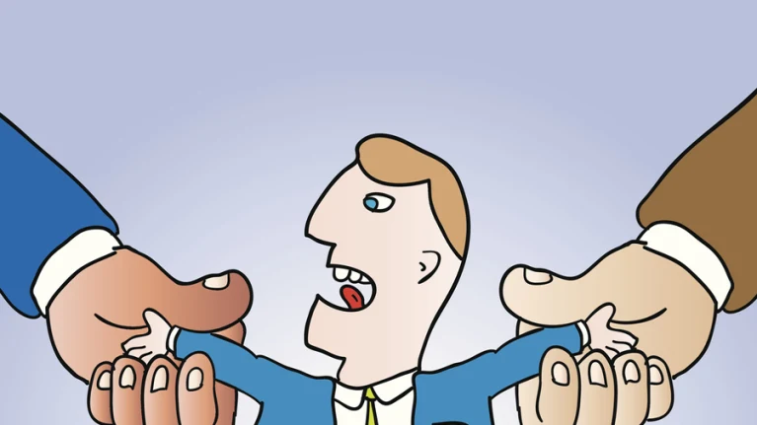
The matrix team
For a matrix team, it is important to overcome the problems staff might have with the dual reporting lines (the ‘two-boss’ problem).
This requires building good interpersonal relationships with the team members and regular, effective communication.

Slide 34
The Contract team
The functional team
Is brought in from outside in order to do the project work.
The client will judge the success of the project.
A variant of this is the so-called “outsourced supply team”: the team is physically situated remotely from the project manager.

Slide 35
Mixed-structure Team
The functional team
Some members may be employed to work full time
Others may work part time
Some may be part of a matrix arrangement
Some others may be part of a functional hierarchy

Slide 36
ACTIVITY 4 - DISCUSION
Which team model is the best for a large and complex problem?
Which team model is normal for a straightforward task?
What are some of the relative benefits and drawbacks to some of these team configurations?

Slide 37
The Modern Teams
03 other important types of team:
“Self-managed teams”
"Self-organizing teams”
"Dispersed Virtual teams”.
Notes:
Disperse (v) /dɪˈspɝːs/: to spread across or move away over a large area, or to make something do this

Slide 38
Comparing Self-managed and Self-Organizing Teams
Self-managed team | Self-organizing team
Usually part of the formal reporting structure | Usually outside the formal reporting structure
Members usually selected by management | Members usually self-selected volunteers
Informal style of working | Informal style of working
Indirectly controlled by senior management | Senior management influences only the team's boundaries
Usually a permanent leader, but may change | Leadership variable – perhaps one, perhaps changing, perhaps shared
Empowered by senior management | Empowered by the team members and a supportive culture and environment

Slide 39
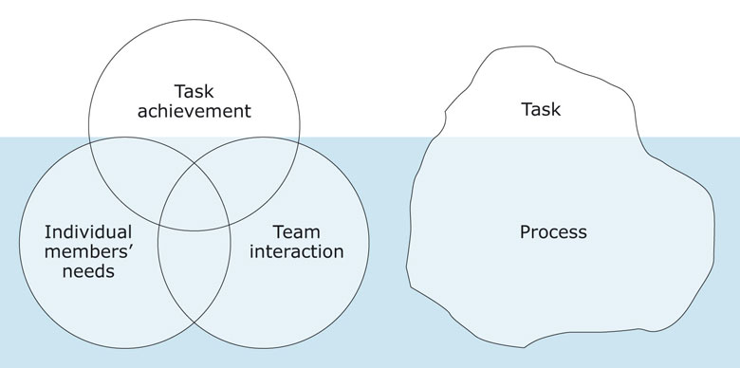
Why do (only some) teams succeed?

Slide 40
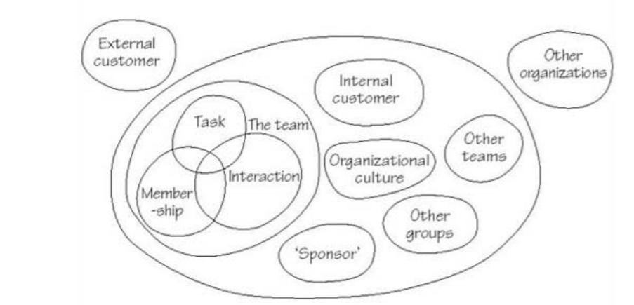
Systems map showing components influencing team effectiveness

Slide 41

Q&A

